Slide 1


Async Patterns
Siva Rallabhandi
Nov 14, 2017

Slide 2

Agenda
1
Callbacks
2
Callback hell
3
Promises
4
Generators
Notes:
Tool: http://google.github.io/traceur-compiler/demo/repl.html#

Slide 3
Callback
A callback function, also known as a higher-order function, is a function that is passed to another function as a parameter, and the callback function is called (or executed) inside the other Function.

Slide 4
setTimeout(function(){
console.log("world");
}, 1000
);
console.log("Hello");
What shows in the console?
Hello
World

Slide 5
function Sum(a,b){
setTimeout(function(){
return a + b;
}, 1000);
}
console.log(Sum(10, 20));
console.log("Hello World");
What shows in the console?
undefined
Hello World

Slide 6
function Sum(a,b, callback){
setTimeout(function(){
callback(a + b);
},1000);
}
Sum(10, 20, function(result){
console.log(result);
});
console.log("Hello World");
What shows in the console?
Hello World
30

Slide 7
https://jsfiddle.net/ninalasiva/72uLeu38/
What shows in the console?
Hello World
30

Slide 8
Callback Hell
Callback hell is the eventual state of any complex callback oriented asynchronous program where the management of callbacks gets so hard that the performance benefits of callbacks notwithstanding, your code becomes extremely hard to understand, reason about and maintain.

Slide 9
function Sum(a,b, callback){
setTimeout(function(){
callback(a + b);
},1000);
}
function ThreeTimes(num, callback){
setTimeout(function(){
callback(Math.pow(num, 3));
}, 1000)
}
function squareRoot(num, callback){
setTimeout(function(){
callback(Math.sqrt(num));
}, 1000)
}
Sum(10, 20, function(result){
ThreeTimes(result, function(result1){
squareRoot(result1, function(result2){
console.log(result2)
});
});
});
What shows in the console?
164.31
Notes:
Refer to the website http://callbackhell.com/ also

Slide 10
function Sum(a,b, callback){
setTimeout(function(){
callback(a + b);
},1000);
}
function ThreeTimes(num, callback){
setTimeout(function(){
callback(Math.pow(num, 3));
}, 1000)
}
function squareRoot(num, callback){
setTimeout(function(){
callback(Math.sqrt(num));
}, 1000)
}
function getThreeTimes(num){
ThreeTimes(num, getsquareRoot);
}
function getsquareRoot(num){
squareRoot(num, displayResult);
}
function displayResult(result){
console.log(result);
}
Sum(10, 20, getThreeTimes)
What shows in the console?
164.31
Notes:
Refer to the website http://callbackhell.com/

Slide 11
Promise
A promise represents the eventual result of an asynchronous operation.
Syntax:
new Promise( /* executor */ function(resolve, reject) { ... } );

Slide 12
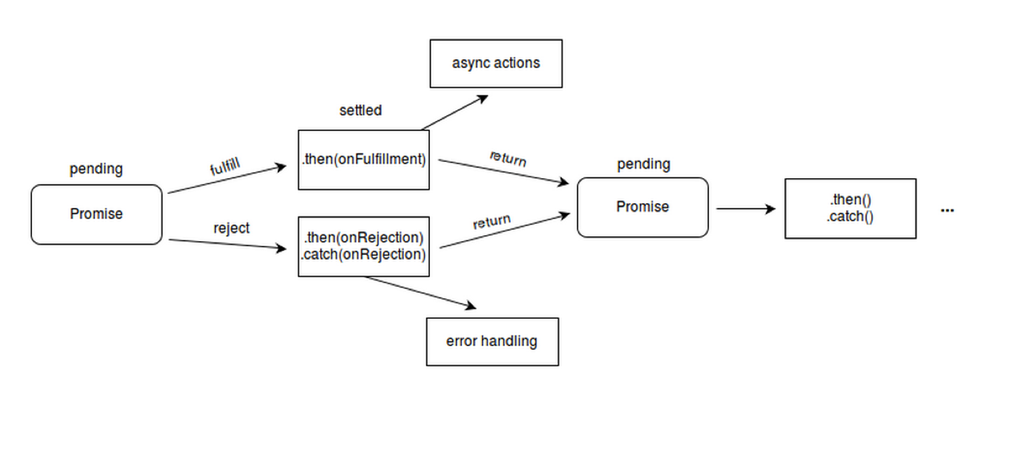
Promise

Slide 13
function getData(d){
return new Promise(function(resolve, reject){
setTimeout(function(){
resolve(d);
}, 1000)
});
}
getData(10).
then(function(num1, err){
var x = 1 + num1;
console.log(x);
return getData(30);
}).then(function(num2){
var y = 1 + num2;
console.log(y);
}).catch(function(err){
console.log(err);
});
What shows in the console?
11
31

Slide 14
function getData(d){
return new Promise(function(resolve, reject){
setTimeout(function(){
reject(new Error('fail'));
}, 1000)
});
}
getData(10).
then(function(num1, err){
var x = 1 + num1;
console.log(x);
return getData(30);
}).then(function(num2){
var y = 1 + num2;
console.log(y);
}).catch(function(err){
console.log(err);
});
What shows in the console?
fail

Slide 15
function Sum(a,b){
return new Promise(function(resolve, reject){
setTimeout(function(){
resolve(a+b);
}, 1000)
});
}
function ThreeTimes(num){
return new Promise(function(resolve, reject){
setTimeout(function(){
resolve(Math.pow(num, 3));
}, 1000)
});
}
function squareRoot(num){
return new Promise(function(resolve, reject){
setTimeout(function(){
resolve(Math.sqrt(num));
}, 1000)
});
}
Sum(10, 20).
then(function(result){
return ThreeTimes(result);
}).
then(function(result1){
return squareRoot(result1);
}).
then(function(result2){
console.log(result2);
});
What shows in the console?
164.316

Slide 16
Generators (yield)
Which can pause the execution in middle of the function and resume later on.
The function* declaration defines a generator function, which returns a Generator object.
Syntax:
function* name([param[, param[, ... param]]]) {
statements
}

Slide 17
function* gen(){
console.log("Hello");
yield null;
console.log("World");
}
it = gen();
it.next();
It.next()
What shows in the console?
Hello
World

Slide 18
function* gen1(){
var n = 1
console.log('This is printed first');
yield n
n += 1
console.log('This is printed second')
yield n
n += 1
console.log('This is printed at last')
yield n
}
it = gen1();
it.next();
it.next();
it.next();
What shows in the console?
This is printed first
This is printed second
This is printed at last

Slide 19
Q & A

Slide 20
THANK YOU
For your attention

